Slide 1

Natural language process
Amazon Reviews sentiment analysis
P-106
Group No. 5
Group member :-
Adhish
Ashish Ponde
Mentor Name :
Ms. pallavi B

Slide 2
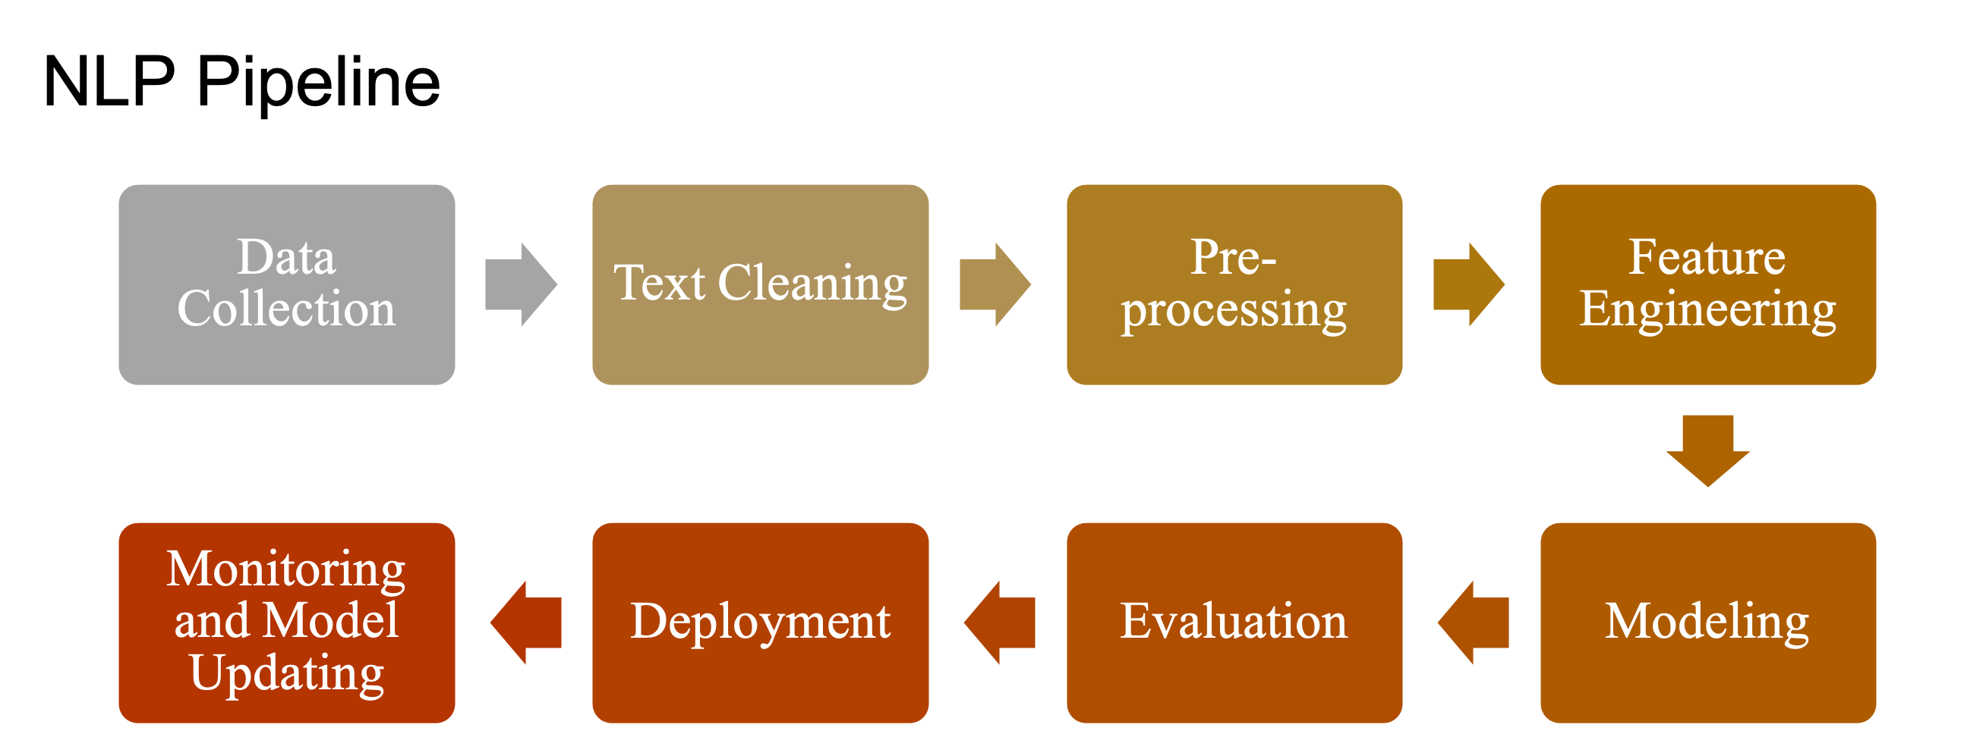

Slide 3
Index
Problem Statement
Step – 1: Data Scraping
Step – II: Reading and Understanding the data
Step – III: Data Preparation
Step – IV : EDA
Step – V : Split data set
Step – VI : Model Building
Step – VII : Deployment

Slide 4
Problem Statement
Business Objective:
Need to get daily Analysis of a product such as emotions, sentiment etc. using Amazon data .It could be any product of your choice.
Architecture level analysis:
Need to pull the data of a product from Amazon
Data transformation/Text processing using R/Python
Need to get daily product sentiments Analysis and Emotion mining with some charts like histogram, Density plot, Barplot, pie-plot etc.
Deployment through R Shiny or Flask/ Streamlit

Slide 5

Step – 1: data Scraping
Data Scraped from amazon.com for product OnePlus-Wireless-Bluetooth-Earphones by using following url.
"https://www.amazon.in/OnePlus-Wireless-Bluetooth-Earphones-Bombastic/product-reviews/B09TVVGXWS/ref=cm_cr_dp_d_show_all_btm?ie=UTF8&reviewerType=all_reviews&pageNumber"

Slide 6
Step – 1i: Reading and Understanding the data
Understanding more about the columns from the “amazon_reviews.csv” file.
Using shape, describe we can get more information about the dataset.

Slide 7
Step – iII: Data Preparation
Calculate the total NaN values in every column.
Removed NaN Values from particular columns.
Text Cleaning
Removed Punctuation marks and Stopwords from Reviews

Slide 8
Step – Iv: EdA
Exploratory Data Analysis is the process of using statistical tools (such as graphs, measures of center, and measures of variation to investigate data sets in order to understand their important characteristics.
Heat Map: Understanding the corrlation between the other variables and “Genre”

Slide 9
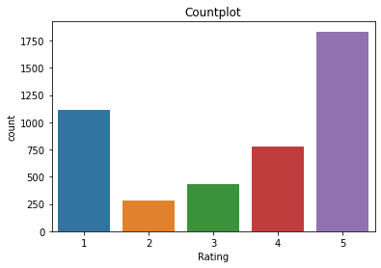
Step – Iv: EdA (Data Visualization)
OnePlus-Wireless-Bluetooth has 41% 5 star ratings & 25% 1 star rating.
so we can say users is satisfied with this product.

Slide 10
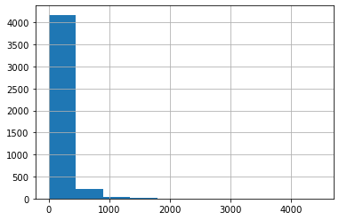
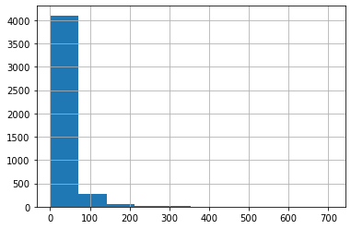
Step – Iv: EdA (Data Visualization)
#The histogram shows that reviews range from 0 to near about 1700 characters and generally, it is between 0 to 1000 characters.
It is clear that the number of words in reviews ranges from 1 to 350 and mostly falls between 0 to 100 words.

Slide 11
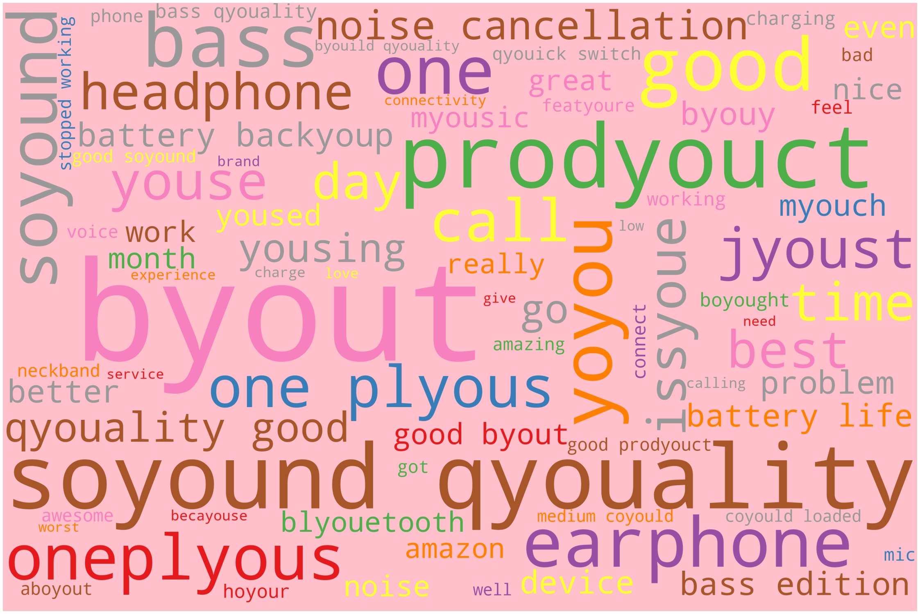
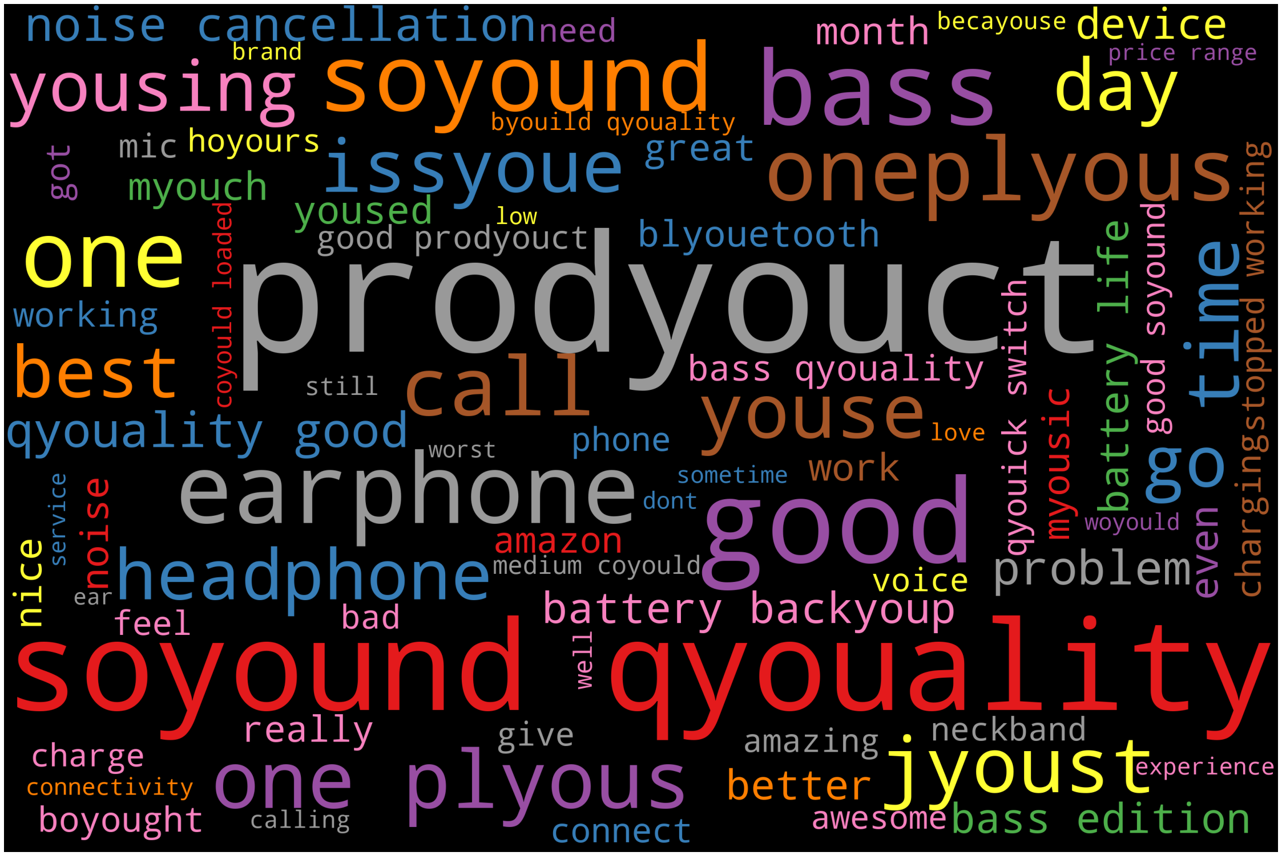
Step – Iv: EdA (Data Visualization)

Slide 12
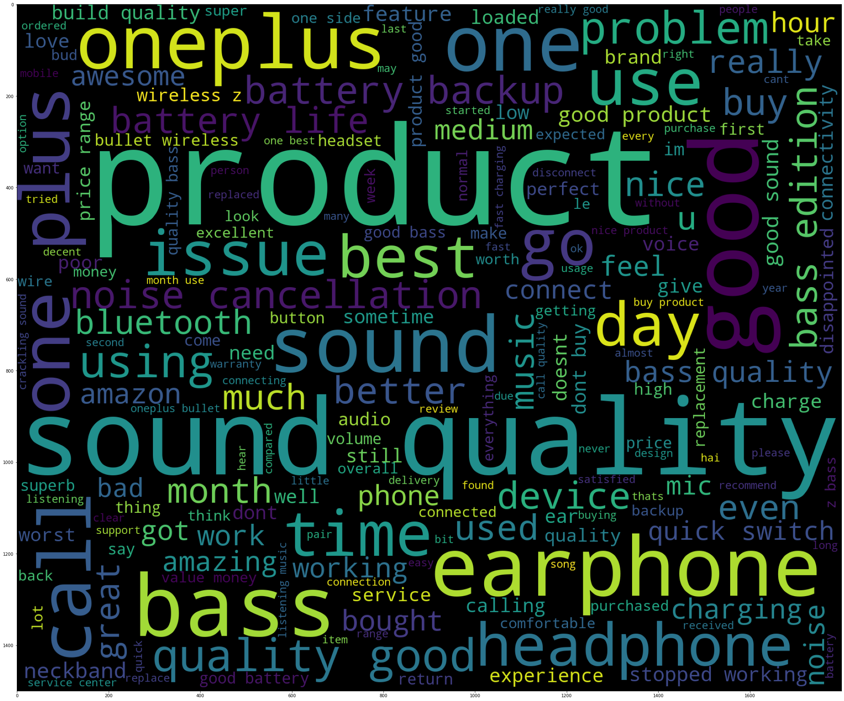
Step – Iv: EdA (Data Visualization)
#Here, we can see that good, sound quality, great, well, are the most frequently occurring words for almost every review . #This means that users are loving products from Amazon and found purchasing them a great decision.

Slide 13
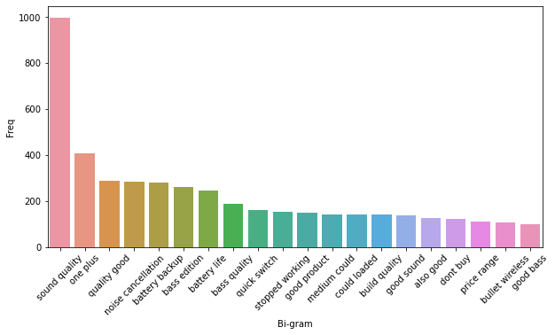
Step – Iv: EdA (Data Visualization)
This bar chart shows the high frequency Bigram words

Slide 14
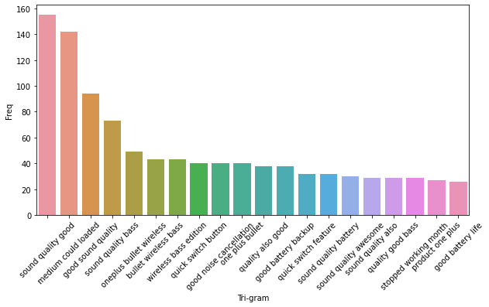
Step – Iv: EdA (Data Visualization)
This bar chart shows the high frequency Trigram words

Slide 15
Step – V : Split the datasets
Using scikit module we can split the data into train-test data. The train and test size is taken as 70% and 30% respectively.
Learning Term weighting and normalizing on entire reviews.
Preparing TFIDF matrix for train reviews and test reviews.

Slide 16
Model building
Using different models to predict the data.
Once the model is built, we can predict the y_train values using predict function.
Repeating the same process on the test set using the predicted values on the test set.
Using the confusion matrix, we can get the accuracy of model.
Campare the values as per train data and test data.

Slide 17
Conclusion:
Sr.No. | Algorithms | Train Accuracy | Test Accuracy
1 | Naïve bayes(Multinomial Naive Bayes) | 79.18% | 75.35%
2 | Decision Tree | 65.62% | 63.82%
3 | Random Forest | 99.90% | 76.85%
4 | KNN | 76.48% | 76.25%
5 | SVM | 96.75% | 79%
SVM model seems to predict the sentiment well and this can give confidence in making good calls.

Slide 18
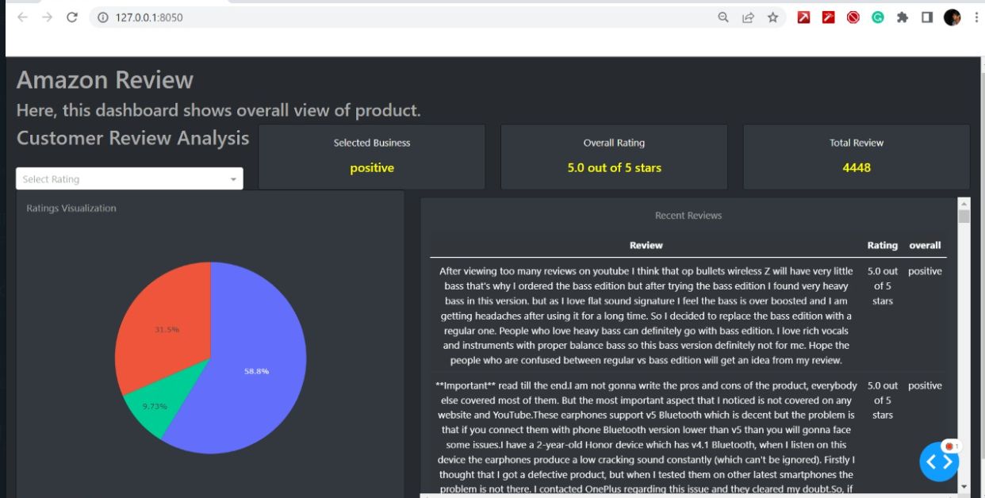
Deployment page:

Slide 19
THANK YOU..!

